Slide 1
CARBOHYDRATE Practical Biochemistry I
Qualitative analysis of carbohydrate
Asst.lec. Dhuha fadhil

Slide 3
Classification
Carbohydrate are classified into
Monosaccharide
Disaccharide
Oligosaccharide
Polysaccharide

Slide 5
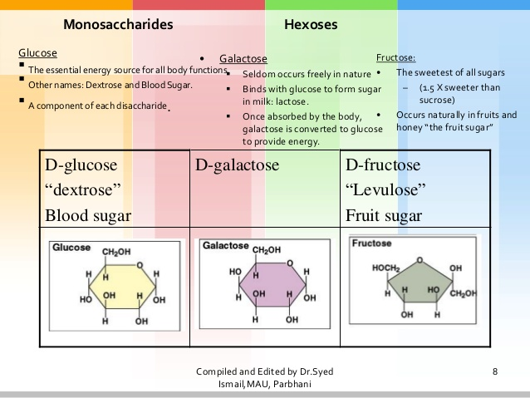

Slide 11
Homework
1 – what is lactose intolerance ,explain the symptom biochemically ?
2- why cellulose can not be digested by human ?
3-what is the importance of fibers in human diet ?
Function of glycogen ?

